Slide 1
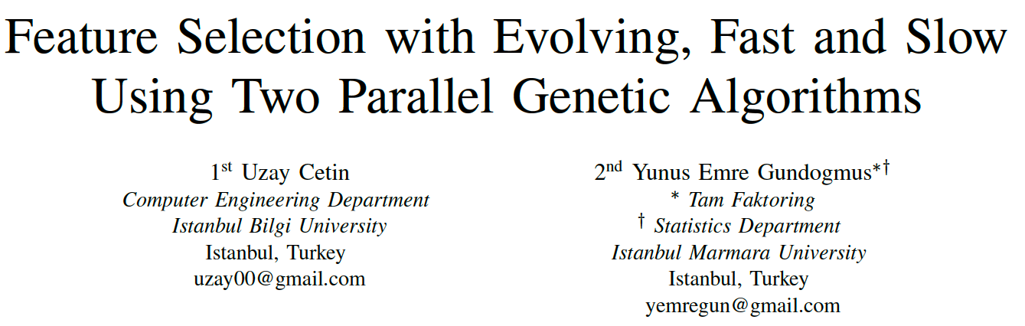
UBMK’19

Slide 2
Introduction
Problem:
Feature selection is one of the most challenging issues in machine learning, especially while working with high dimensional data.
Proposed Solution :
Evolving Fast and Slow,a new feature selection algorithm design based on using two parallel genetic algorithms having high and low mutation rates, respectively.
2/11

Slide 3
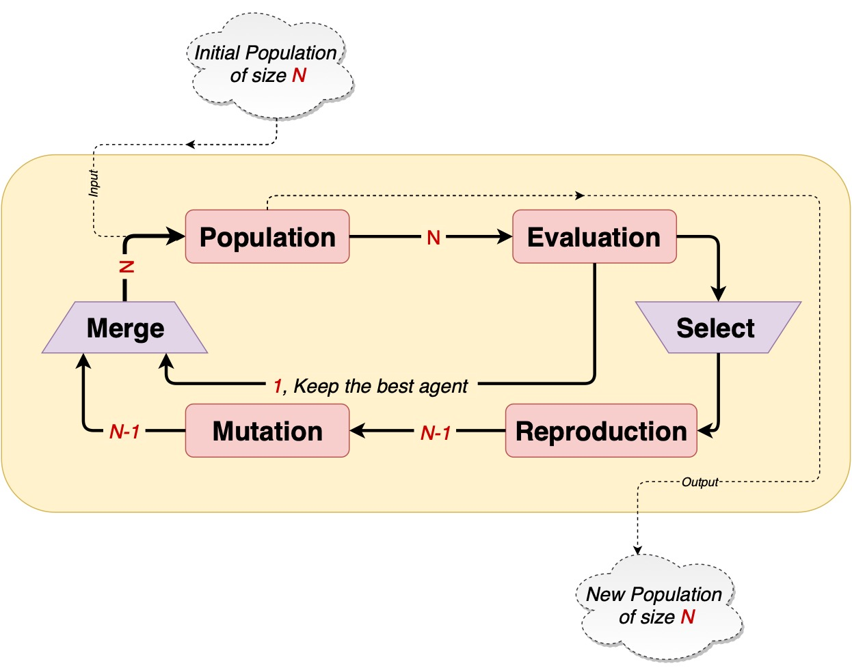
Standard Genetic Algorthm
3/11

Slide 4
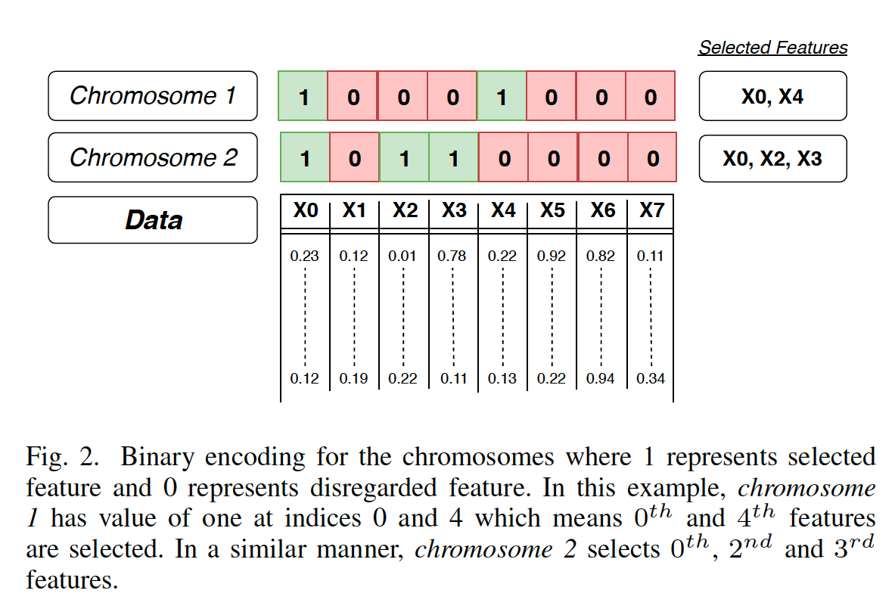
Genetic Algorthm For Feature Selection
Encoding
4/11

Slide 5
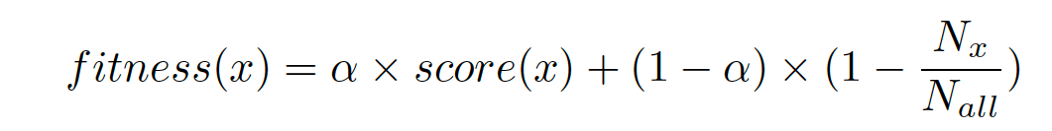
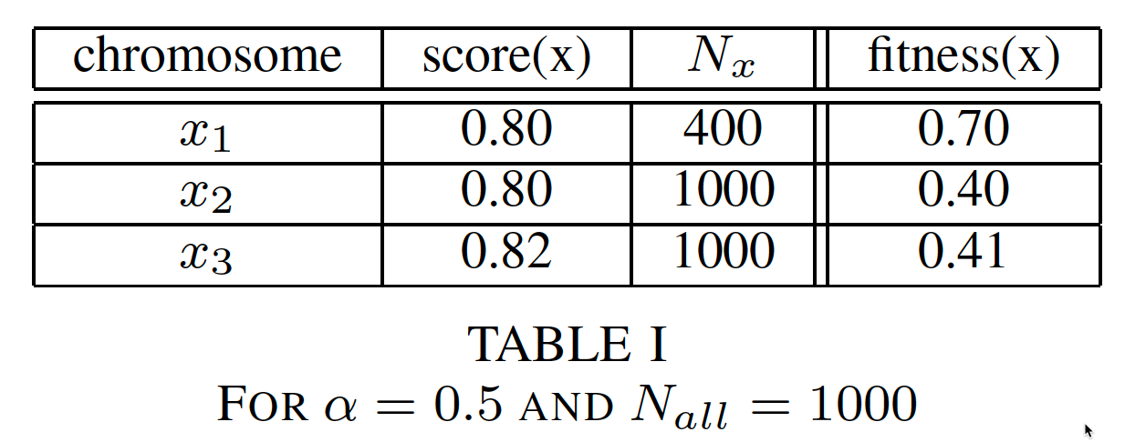
Genetic Algorthm For Feature Selection
Evaluation & Fitness
Score(x) : Cross validation accuracy score (to be maximized)
Nx / Nall : Ratio of selected features (to be minimized)
5/11

Slide 6
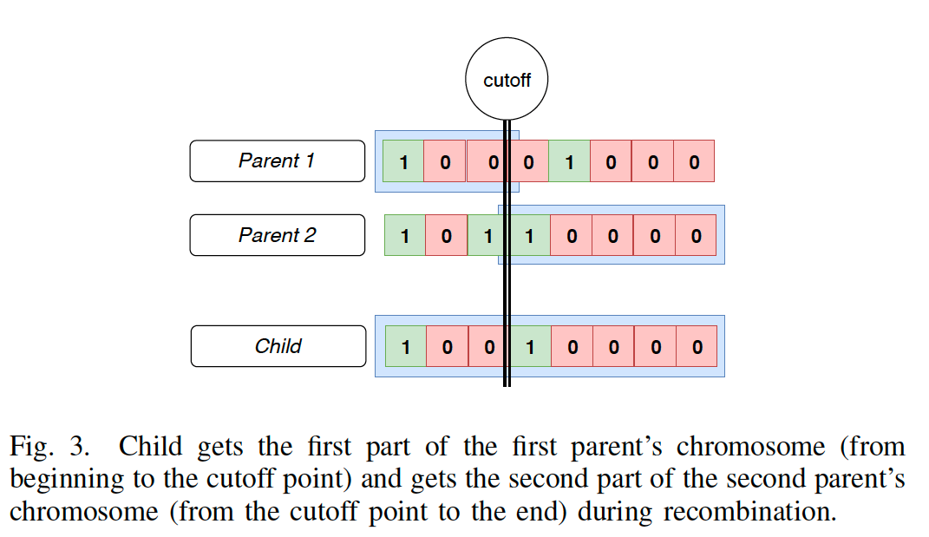
Genetic Algorthm For Feature Selection
Reproduction
Parents selected acc to fitness values. Recombination is followed by mutation.
6/11

Slide 7
EVOLVING, FAST AND SLOW
inspired from Thinking, Fast and Slow written by the world’s most influential living psychologist Nobel Laureate Daniel Kahneman.
“System 1 (Thinking Fast) continuously generates
suggestions for System 2 (Thinking Slow): impressions,
intuitions, intentions, and feelings. If endorsed by System 2, impressions and intuitions turn into beliefs, and impulses turn into voluntary actions.”

Slide 8
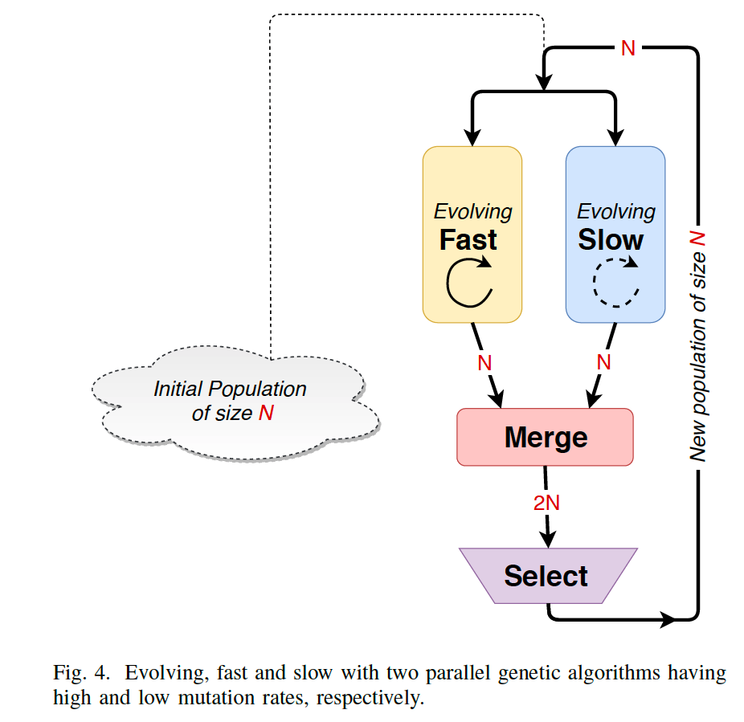
EVOLVING, FAST AND SLOW
Exploration and Exploitation in Unison
New parallel architecture is a combination of
an automatic system that evolves fast
and an effortful system that evolves slow.

Slide 9
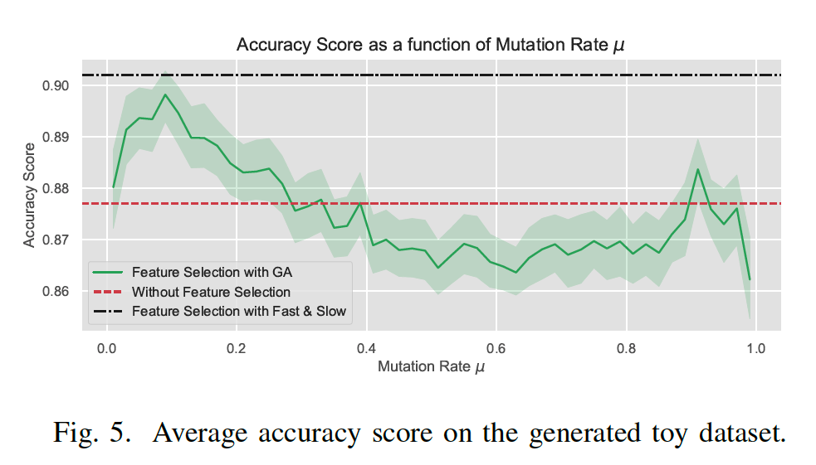
Results and Discussion
Toy Dataset
10000 sample, 50 feature. Y equals to 1 or 0 depending only the first 10 features. The remaining 40 features are noise.
An efficient Feature selection algorithm should select only the first ten.
Parameters:
Alpha =1,
number of generations = 20,
average over 50 runs,
mutation rates slow 0.1 and fast 1
9/11

Slide 10
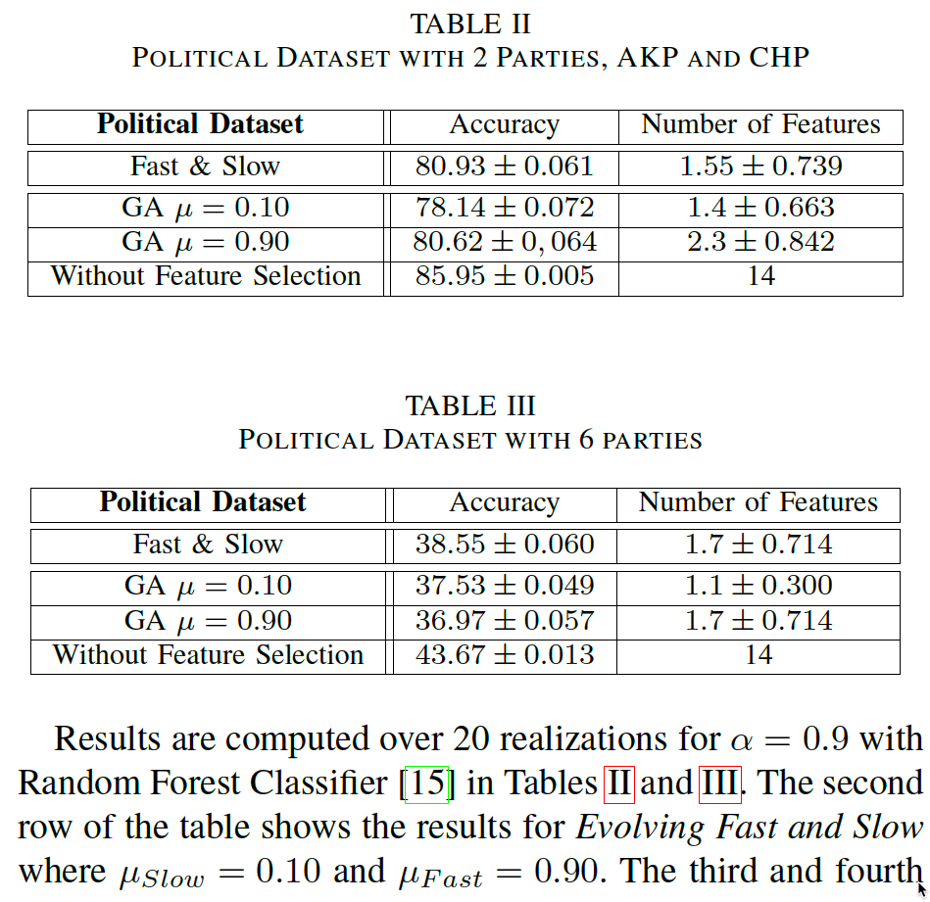
Turkish political climate dataset
opinion of the individual voters on a variety of political issues related to Turkish politics.
Dataset has 885 rows and 14 columns.

Slide 11
Conclusions and Future Research
We proposed a new feature selection algorithm design called Evolving Fast and Slow for classification problems based on using two parallel genetic algorithms having high and low mutation rates, respectively.
Our approach can easily be extended to regression problems.
There are several benefits of genetic algorithms, first of all it is inherently parallel and can be easily distributed. It always finds a solution. With correct hyper-parameter settings, solutions found gets better.
We leave a systematic search of hyper-parameters for different kind of real datasets as a future work.
One of the key advantage of this work, is that this method can decide the number of features to be selected on its own, whereas most of the existing feature selection algorithms requires the number of selected features as an input.
Apart from feature selection, algorithm selection can also be done via genetic algorithms. (Auto ML)
11/11

Slide 12
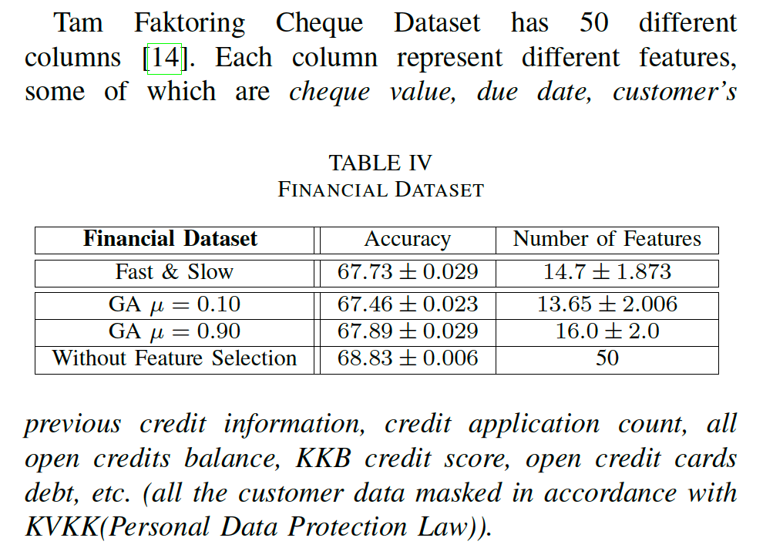
Tam Faktoring Cheque Dataset
Results are again computed over 20 realizations for alpha = 0.9 for the financial dataset

